Slide 1

If you torture the data long enough, it will confess!
- Ronald Coase

Slide 2
What is Regression?
Regression is a tool for finding existence of an association relationship between a dependent variable (Y) and one or more independent variables (X₁, X₂, …, X_{n}) in a study.
The relationship can be linear or non-linear.
A dependent variable (response variable) “measures an outcome of a study (also called outcome variable)”.
An independent variable (explanatory variable) “explains changes in a response variable”.
Regression often set values of explanatory variable to see how it affects response variable (predict response variable)

Slide 3
Regression
Regression is a supervised learning algorithm under Machine Learning terminology
An important tool in Predictive Analytics

Slide 4
Regression model establishes existence of association between two variables, but not causation.

Slide 5
Girlfriends and wives create such a “distraction” that Indian batsmen can’t make runs, bowlers fail to take wickets and fielders drop simple catches.
BCCI Bans Girlfriends and Wives
Regression is not designed to capture causal relationship

Slide 6
Dependent and Independent are just terms used!
Married Men Earn More Money!
Is marriage leading to more money or More Money leading to Marriage?

Slide 7
Regression helps to validate hypothesis

Slide 8
Interesting Hypotheses
Good looking couples are more likely to have girl child(ren)!
Married people are more happier than singles!!!
Vegetarians miss fewer flights.
Black cars have more chance of involving in an accident than white cars in moon light.
Women use camera phone more than men.
Left handed men earn more money!
Smokers are better sales people.
Those who whistle at workplace are more efficient.

Slide 9
Regression - Definition
A statistical technique that attempts to determine the existence of a possible relationship between one dependent variable (usually denoted by Y) and a collection of Independent variables.
Regression is used for generating new hypothesis and for validating a hypothesis

Slide 10
Dependent and Independent Variables
Terms dependent and independent does not necessarily imply a causal relationship between two variables.
Regression is not designed to capture causality.
Purpose of regression is to predict the value of dependent variable given the value(s) independent variable(s)

Slide 11
Regression Nomenclature
Dependent Variable | Independent Variable
Explained Variable | Explanatory variable
Regressand | Regressor
Predictand | Predictor
Endogenous Variable | Exogenous Variable
Controlled Variable | Control Variable
Target Variable | Stimulus Variable
Response Variable | Feature
Outcome variable | Input variable

Slide 12
Regression Vs Correlation
Regression is the study of, “existence of a relationship”, between two variable. The main objective is to estimate the change in mean value of independent variable.
Correlation is the study of, “strength of relationship”, between two variables.

Slide 13
Correlation
Sample Covariance(X,Y)=
(n-1): Bessel’s correction for an unbiased estimate.
Correlation (X,Y) =
Covariance (X,Y)/ (Stdev(X)*Stdev(Y))

Slide 14
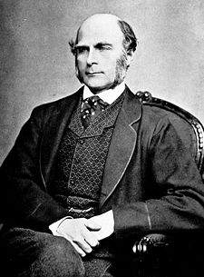
Regression History
Francis Galton was the first to apply regression.
Claimed that height of children of tall parents “regress towards mean of that generation”.
Modern regression analysis is developed by R A Fisher.
Francis Galton
Ref: F Galton, “Regression towards mediocrity in hereditary stature”, Nature, Vol. 15, 246-263, 1886

Slide 15
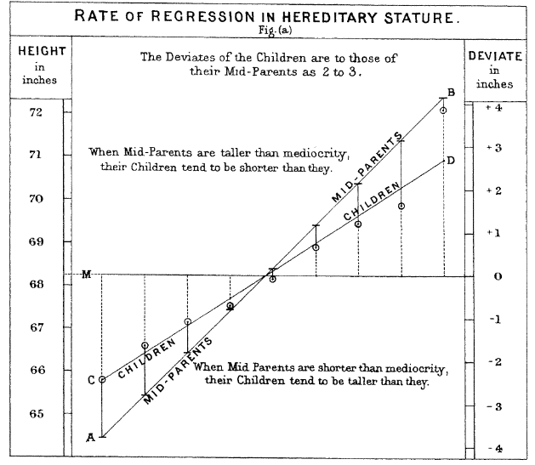
Sir Francis Galton’s Regression to Mean Graph

Slide 16
Where is it used?
Every functional area of management uses regression.
Finance: CAPM, Non-performing assets, probability of default, Chance of bankruptcy, credit risk.
Marketing: Sales, market share, customer satisfaction, customer churn, customer retention, customer life time value.
Operations: Inventory, productivity, efficiency.
HR – Job satisfaction, attrition.

Slide 17
Importance of Regression
In 1980, Supreme court of USA recognized regression as a valid method of identifying discrimination.
American Food and Drug Administration (FDA) uses regression as an approved tool for validating food and drug products.

Slide 18
Why we need Regression?
Companies would like to know about factors that has significant impact on their Key Performance Indicators (KPI).
Regression helps to create new hypothesis that may assist the companies to improve their performance.

Slide 19
Types of Regression

Slide 20
Types of Regression
Regression Models
Simple Regression
Multiple Regression
Linear
Non-linear
Linear
Non-linear
One independent variable
More than One independent variable

Slide 21
Types of Regression
Simple linear regression – refers to a regression model between two variables.
Multiple linear regression – refers to a regression model on more than one independent variables.
Nonlinear regression.

Slide 22
Linear Regression
Linear regression stands for a function that is linear in regression coefficients.
The following equation will be treated as linear as far as regression is concerned.

Slide 23
Regression Model Development

Slide 24
Simple Linear Regression Model Building
A simple linear regression model is developed to understand how the value of a KPI is associated with changes in the values of an independent variable.
Some examples are as follows:
A hospital may be interested in finding how the total treatment cost of a patient varies with the body weight of the patient.
E-commerce companies such as Amazon, Bigbasket and Flipkart would like to understand the number of customer visits to their portal and the revenue.
Retailers such as Walmart, Target, Reliance Retail, Hyper City, etc. would be interested in understanding the impact of price cut promotions on the revenue of their private labels (store brands or house brands).
Original equipment manufacturers (OEMs) would like to know the impact of duration of warranty on the profit.

Slide 25
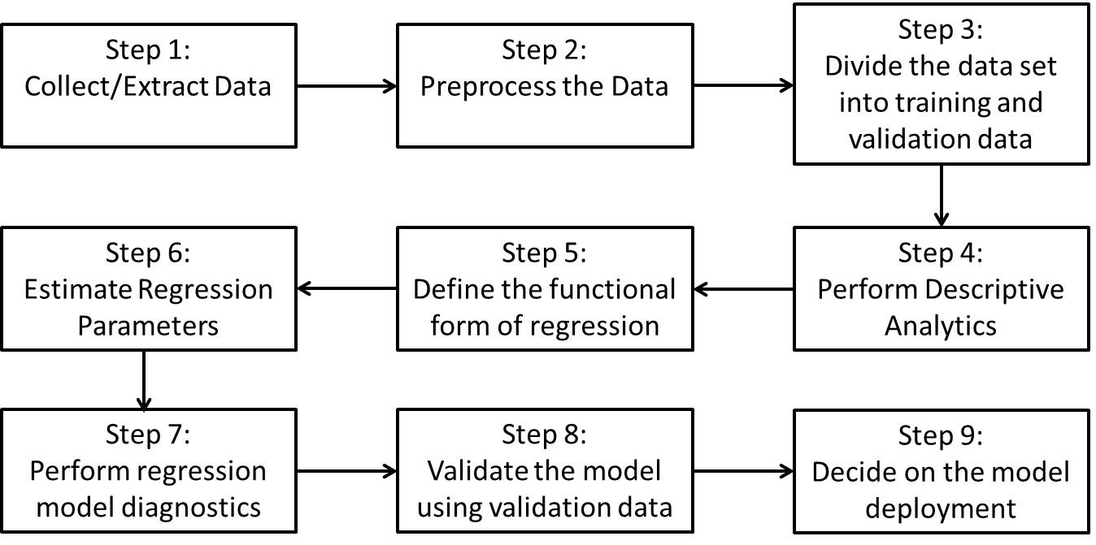
Framework for SLR model development

Slide 26
Regression model building STEPS
Step 1: Collect/Extract Data
The first step in building a regression model is to collect and/or extract data from different sources for the identified problem (or KPI). Data collection, however can be time-consuming and expensive.
Since ERP (enterprise resource planning) systems that are used for collecting and storing the data are not designed for analytics applications (which is probably changing in the recent past), data extraction from the ERP systems becomes a time-consuming process.
Another issue with data collection is that it can be expensive. For example, let us assume that a modeller believes that the amount spent by a customer in a retail store would be dependent on the customer’s income. However, not many customers may like to reveal their income, thus making it difficult and expensive to collect the required data. In general, data that is seen as too personal may be difficult to collect and verify. Also regulations across many countries forbid collecting/sharing sensitive personal information.

Slide 27
Step 2: Pre-process the Data
Pre-processing the data is an important stage in the regression model building and is required for many reasons. For example, Francis Galton multiplied the height of every female by 1.08 to make it comparable to the heights of males (Hanley, 2004).
An important aspect of data pre-processing is that the modeller has to decide how he/she would use the data in the model building. Many new variables (such as ratio of variables or product of variables) can be derived and can be used in model building.
Categorical variables (Qualitative variables or nominal scale variables) in the dataset cannot be used directly in the model since it can create model misspecification.

Slide 28
Step 3: Divide the Data into Training and Validation Data Sets
In this stage the data is divided into two subsets (sometimes more than two subsets): training data set and validation data set. The proportion of training data set is usually between 70% and 80% and the remaining data is treated as the validation data
In many cases, the original data set may be partitioned into three partitions: training, validation and test data. This is done especially in machine learning algorithms.
Step 4: Perform Descriptive Analytics
Descriptive statistics will help us to understand the variability in the model and visualization of the data through, say, a box plot which will show if there are outliers in the data.

Slide 29
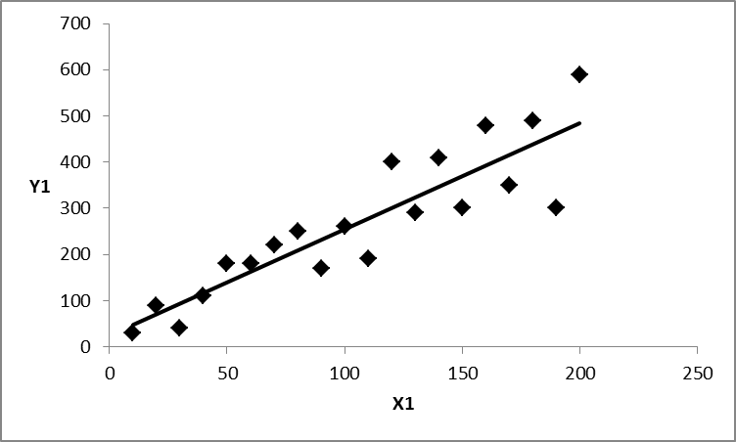
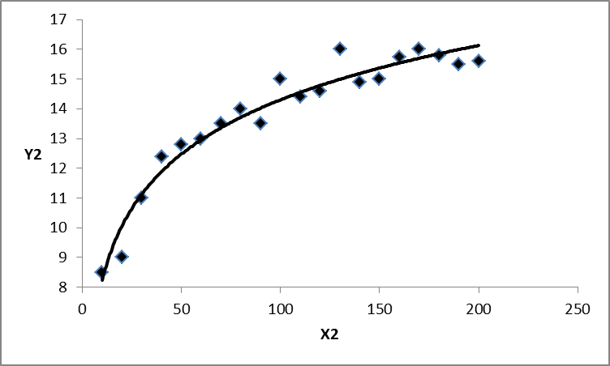
Step 5: Define the Functional Form of Relationship
For better predictive ability (model accuracy) it is important to specify the correct functional form between the dependent variable and the independent variable. Scatter plots may assist the modeller to define the right functional form.
Linear relationship between X₁ and Y₁
Log-linear relationship between X₂ and Y₂.

Slide 30
Step 6: Estimate the Regression Parameters
Once the functional form is specified, the next step is to estimate the regression parameters. The method of Ordinary Least Squares (OLS) is used to estimate the regression parameters.
OLS fits regression line through a set of data points such that the sum of the squared distances between the actual observations in the sample and the regression line is minimized (i.e., is minimized ).
OLS provides the Best Linear Unbiased Estimate (BLUE). That is, where is the population parameter and is estimated parameter value from the sample.

Slide 31
Step 7: Perform Regression Model Diagnostics
Regression is often misused since many times the modeller fails to perform necessary diagnostics tests before applying the model.
Before it can be applied it is necessary that the model created is validated for all model assumptions including the definition of the function form.
If the model assumptions are violated, then the modeller has to use some remedial measure; it is also possible that there is no association relationship between the variables at all.

Slide 32
Step 8: Validate the Model using the Validation Data Set
A major concern in analytics is over-fitting, that is, the model may perform very well in the training data set but may perform badly in validation data set. It is important to ensure that the model performance is consistent in the validation data set as was in the training data set. In fact, the model may be cross-validated using multiple training and test data sets.
Step 9: Decide on the Model Deployment
The final step in the regression model is to generate actionable items and business rules that can be used by the organization

Slide 33
Estimation of Parameters using Ordinary Least Squares
Given a set of dependent variable values (Y_{i}) and the corresponding independent variable values (X_{i}), each subject to a random error (ε_{i}), one has to find the best equation to represent the relationship between the dependent and independent variables.

Slide 34
OLS Estimation
In ordinary least squares, the objective is find the optimal values of ₀ and ₁ that will minimize the Sum of Squared Errors (SSE) given in belwo Eq:
To find the optimal values of β₀ and β₁ that will minimize SSE, we have to equate the partial derivative of SSE with respect to β₀ and β₁ to zero.

Slide 35
OLS Estimation
Solving the system of equations for β0 and β1, we get the estimated values as follows:

Slide 36
Example :
Salary of Graduating MBA Students versus Their Percentage Marks in Grade 10
Table in next slide provides the salary of 50 graduating MBA students of a Business School in 2016 and their corresponding percentage marks in grade 10 . Develop a linear regression model by estimating the model parameters.

Slide 37
Salary of MBA students versus their grade 10 marks
S. No. | Percentage in Grade 10 | Salary | S. No. | Percentage in Grade 10 | Salary
1 | 62 | 270000 | 26 | 64.6 | 250000
2 | 76.33 | 200000 | 27 | 50 | 180000
3 | 72 | 240000 | 28 | 74 | 218000
4 | 60 | 250000 | 29 | 58 | 360000
5 | 61 | 180000 | 30 | 67 | 150000
6 | 55 | 300000 | 31 | 75 | 250000
7 | 70 | 260000 | 32 | 60 | 200000
8 | 68 | 235000 | 33 | 55 | 300000
9 | 82.8 | 425000 | 34 | 78 | 330000
10 | 59 | 240000 | 35 | 50.08 | 265000
11 | 58 | 250000 | 36 | 56 | 340000
12 | 60 | 180000 | 37 | 68 | 177600
13 | 66 | 428000 | 38 | 52 | 236000
14 | 83 | 450000 | 39 | 54 | 265000
15 | 68 | 300000 | 40 | 52 | 200000
16 | 37.33 | 240000 | 41 | 76 | 393000
17 | 79 | 252000 | 42 | 64.8 | 360000
18 | 68.4 | 280000 | 43 | 74.4 | 300000
19 | 70 | 231000 | 44 | 74.5 | 250000
20 | 59 | 224000 | 45 | 73.5 | 360000
21 | 63 | 120000 | 46 | 57.58 | 180000
22 | 50 | 260000 | 47 | 68 | 180000
23 | 69 | 300000 | 48 | 69 | 270000
24 | 52 | 120000 | 49 | 66 | 240000
25 | 49 | 120000 | 50 | 60.8 | 300000

Slide 38
Solution
Using Eqs., the estimated values of ₀ and ₁ are given by
The corresponding regression equation is given by
Where is the predicted value of Y for a given value of X_{i}. .
The equation can be interpreted as follows: for every one percentage increase in grade 10 marks, the salary of the MBA students will increase at the rate of 3076.1774 on an average. The notations

Slide 39
Solution Continued
are used to denote that these are estimated values of the regression coefficients from the sample of 50 students.
The Microsoft Excel output for SLR model is shown in Table
 | Coefficients | Standard Error | t-stat | p-value
Intercept | 61555.35534 | 66701.901 | 0.9228 | 0.3607
Percentage in grade 10 | 3076.177438 | 1031.5258 | 2.9821 | 0.0044

Slide 40
Interpretation of Simple Linear Regression Coefficients
Interpretation of regression coefficients is important for understanding the relationship between the response variable and the explanatory variable and the impact of change in the values of explanatory variables on the response variable.
The interpretation will depend on the functional form of the relationship between the response and the explanatory variables.
Interpretation of β₀ and β₁ in Y = ₀ + ₁ X
When the functional form is Y = β₀ + β₁ X, the value of β₀ = E(Y|X=0).
β₁ = that is β₁ is the change in the value of Y for the unit change in the value of X. Where is the partial derivative of Y with respect to X.

Slide 41
Validation of the Simple Linear Regression Model
It is important to validate the regression model to ensure its validity and goodness of fit before it can be used for practical applications. The following measures are used to validate the simple linear regression models:
Co-efficient of determination (R-square).
Hypothesis test for the regression coefficient
Analysis of Variance for overall model validity (relevant more for multiple linear regression).
Residual analysis to validate the regression model assumptions.
Outlier analysis.
The above measures and tests are essential, but not exhaustive.

Slide 42
Coefficient of Determination (R-Square or R²)
The co-efficient of determination (or R-square or R²) measures the percentage of variation in Y explained by the model (β₀ + β₁ X).
The simple linear regression model can be broken into explained variation and unexplained variation as shown in
In absence of the predictive model for Y_{i}, the users will use the mean value of Y­_{i}. Thus, the total deviation is measured as the difference between Y_{i} and mean value of Y_{i} (i.e.,Y_{i} - ).

Slide 43
Description of total deviation, explained deviation and unexplained deviation
Variation Type | Measure | Description
Total Deviation | ( ) | Total deviation is the difference between the actual value and the mean value.
Deviation explained by the model | ( ) | Deviation explained by the model is the difference between the estimated value of Y_{i} and the mean value of Y
Deviation not explained by model | ( ) | Deviation not explained by the model is the difference between the actual value and the predicted value of Y_{i} (error in prediction)

Slide 44
The relationship between the total deviation, explained deviation and the unexplained deviation is given as follows:
It can be proved mathematically that sum of squares of total variation is equal to sum of squares of explained variation plus sum of squares of unexplained variation
where SST is the sum of squares of total variation, SSR is the sum of squares of variation explained by the regression model and SSE is the sum of squares of errors or unexplained variation.

Slide 45
Coefficient of Determination or R-Square
The coefficient of determination (R²) is given by
Since SSR = SST – SSE, the above Eq. can be written as

Slide 46
Coefficient of Determination or R-Square
Thus, R² is the proportion of variation in response variable Y explained by the regression model. Coefficient of determination (R²) has the following properties:
The value of R² lies between 0 and 1.
Higher value of R² implies better fit, but one should be aware of spurious regression.
Mathematically, the square of correlation coefficient is equal to coefficient of determination (i.e., r² = R²).
We do not put any minimum threshold for R²; higher value of R² implies better fit. However, a minimum value of R² for a given significance value α can be derived using the relationship between the F-statistic and R²

Slide 47
Spurious Regression
Number of Facebook users and the number of people who died of helium poisoning in UK
Year | Number of Facebook users in millions (X) | Number of people who died of helium poisoning in UK (Y)
2004 | 1 | 2
2005 | 6 | 2
2006 | 12 | 2
2007 | 58 | 2
2008 | 145 | 11
2009 | 360 | 21
2010 | 608 | 31
2011 | 845 | 40
2012 | 1056 | 51

Slide 48
Facebook users versus helium poisoning in UK
SUMMARY OUTPUT
Regression Statistics
Multiple R | 0.996442
R Square | 0.992896
Standard Error | 1.69286
Observations | 9
ANOVA
 |  | SS | MS | F | Significance F
Regression | 1 | 2803.94 | 2803.94 | 978.4229 | 8.82E-09
Residual | 7 | 20.06042 | 2.865775
Total | 8 | 2824
 | Coefficients | Standard Error | t-stat | P-value | Lower 95% | Upper 95%
Intercept | 1.9967 | 0.76169 | 2.62143 | 0.034338 | 0.195607 | 3.79783
FB | 0.0465 | 0.00149 | 31.27975 | 8.82E-09 | 0.043074 | 0.050119
The R-square value for regression model between the number of deaths due to helium poisoning in UK and the number of Facebook users is 0.9928. That is, 99.28% variation in the number of deaths due to helium poisoning in UK is explained by the number of Facebook users.
The regression model is given as Y = 1.9967 + 0.0465 X

Slide 49
Hypothesis Test for Regression Co-efficient (t-Test)
The regression co-efficient ( β₁) captures the existence of a linear relationship between the response variable and the explanatory variable.
If β₁ = 0, we can conclude that there is no statistically significant linear relationship between the two variables.

Slide 50
The estimate of β₁ using OLS is given by
Above eq. can be written as follows:
That is, the value of β₁ is a function of Y_{i} (K_{i} is a constant since X_{i} is assumed to be non-stochastic)

Slide 51
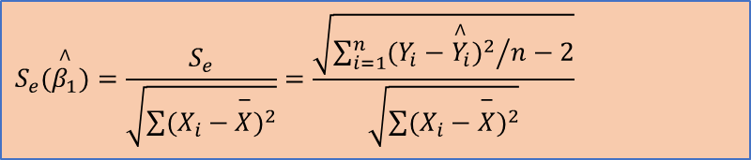
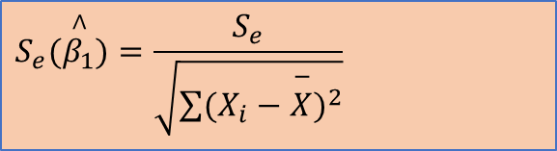
The standard error of β₁ is given by
In above Eq. S_{e} is the standard error of estimate (or standard error of the residuals) that measures the accuracy of prediction and is given by
$$S_{e}(\overset{∧}{β_{1}})=\frac{S_{e}}{\sqrt{\sum{(X_{i}−\overset{−}{X})^{2}}}}$$
The denominator in above Eq. is (n − 2) since β₀ and β₁ are estimated from the sample in estimating Y_{i} and thus two degrees of freedom are lost. The standard error of can be written as
$$S_{e}(\overset{∧}{β_{1}})=\frac{S_{e}}{\sqrt{\sum{(X_{i}−\overset{−}{X})^{2}}}}=\frac{\sqrt{{\sum_{i=1}^{n}{(Y_{i}−{\overset{∧}{Y}}_{i})^{2}}}/{n−2}}}{\sqrt{\sum{(X_{i}−\overset{−}{X})^{2}}}}$$

Slide 52
The null and alternative hypotheses for the SLR model can be stated as follows:
H₀: There is no relationship between X and Y
H_{A}: There is a relationship between X and Y
β₁ = 0 would imply that there is no linear relationship between the response variable Y and the explanatory variable X. Thus, the null and alternative hypotheses can be restated as follows:
  H₀: β₁ = 0
  H_{A}: β₁ ≠ 0
The corresponding t-statistic is given as

Slide 53
Test for Overall Model: Analysis of Variance (F-test)
The null and alternative hypothesis for F-test is given by
H₀: There is no statistically significant relationship between Y and any of the explanatory variables (i.e., all regression coefficients are zero).
H_{A}: There is statistically significant relationship between Y and at least one of the explanatory variables.
Alternatively:
H₀: All regression coefficients are equal to zero
H_{A}: Not all regression coefficients are equal to zero
The F-statistic is given by

Slide 54
Assumptions
The method of least squares gives the best equation under the assumptions stated below (Harter 1974, 1975):
The regression model is linear in regression parameters.
The explanatory variable, X, is assumed to be non-stochastic (i.e., X is deterministic).
The conditional expected value of the residuals, E(ε_{i}|X_{i}), is zero.
In case of time series data, residuals are uncorrelated, that is, Cov(ε_{i}, ε_{j}) = 0 for all i ≠ j.
The residuals, ε_{i}, follow a normal distribution.
The variance of the residuals, Var(εi|Xi), is constant for all values of Xi. When the variance of the residuals is constant for different values of Xi, it is called homoscedasticity. A non-constant variance of residuals is called heteroscedasticity

Slide 55
Residual Analysis
Residual (error) analysis is important to check whether the assumptions of regression models have been satisfied. It is performed to check the following:
The residuals are normally distributed.
The variance of residual is constant (homoscedasticity).
The functional form of regression is correctly specified.
If there are any outliers

Slide 56
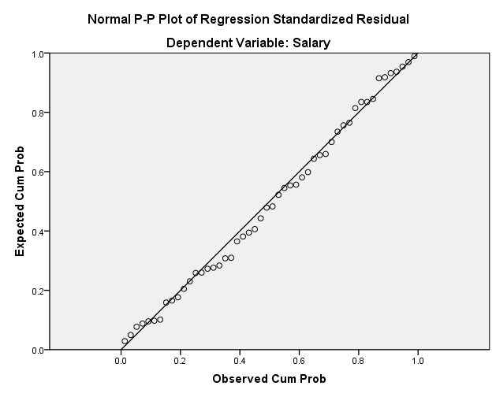
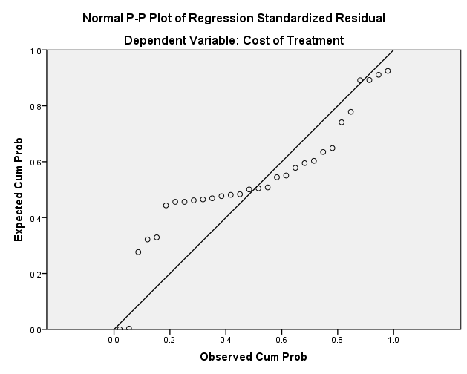
Checking for Normal Distribution of Residuals
The easiest technique to check whether the residuals follow normal distribution is to use the P-P plot (Probability-Probability plot).
The P-P plot compares the cumulative distribution function of two probability distributions against each other

Slide 57
Checking for Normal Distribution of Residuals
Statistical Tests to check for the Normal Distribution of Residuals- Shapiro-Wilk’s test.
H0: Data comes from normal distribution
H1: Data does not follow normal distribution
As the first step, the given data is ordered (ascending) and standardized.
The ordered and standardized data is matched with the quantiles of standard normal distribution.

Slide 58
Checking for Normal Distribution of Residuals
The Shapiro-Wilks (W) test statistic is calculated.
W takes values between 0 &1.
W=1 indicates perfect fit.
We use p-value associated with the test to draw conclusions.
If p-value >= alpha (0.05) then Do Not Reject H0 i.e. data is normally distributed.

Slide 59
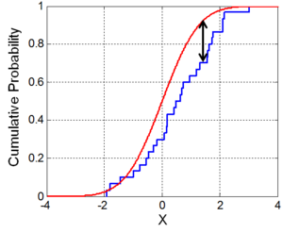
Checking for Normal Distribution of Residuals
Statistical Tests to check for the Normal Distribution of Residuals- Kolmogorov-Smirnov (K-S) test.
H0: Data comes from reference distribution
H1: Data does not come from reference distribution

Slide 60
Checking for Normal Distribution of Residuals
We use p-value associated with the test to draw conclusions.
If p-value >= alpha (0.05) then Do Not Reject H0 i.e. data comes from reference distribution (data is normally distributed).

Slide 61
Checking for Normal Distribution of Residuals
Unless the residuals follow normal distribution, the t-test (used to validate the linear relationship between Y & X) & the F-test (used for overall model validity) results are not valid.
Since the results of these tests are in doubt (for non-normal residuals), there is doubt on the validity of the linear regression model.
Both the t-test & F-test requires a normally distributed population.

Slide 62
Test of Homoscedasticity
An important assumption of regression model is that the residuals have constant variance (homoscedasticity) across different values of the explanatory variable (X).
That is, the variance of residuals is assumed to be independent of variable X. Failure to meet this assumption will result in unreliability of the hypothesis tests.
Testing the Functional Form of Regression Model
Any pattern in the residual plot would indicate incorrect specification (misspecification) of the model.

Slide 63
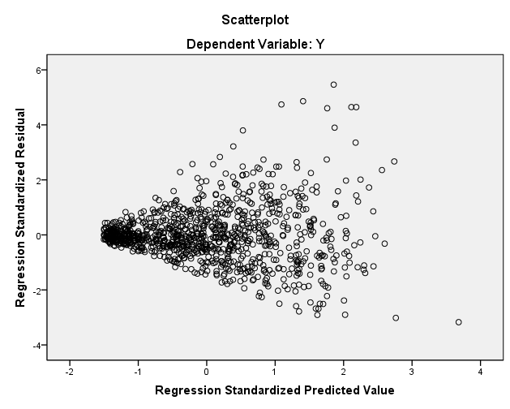
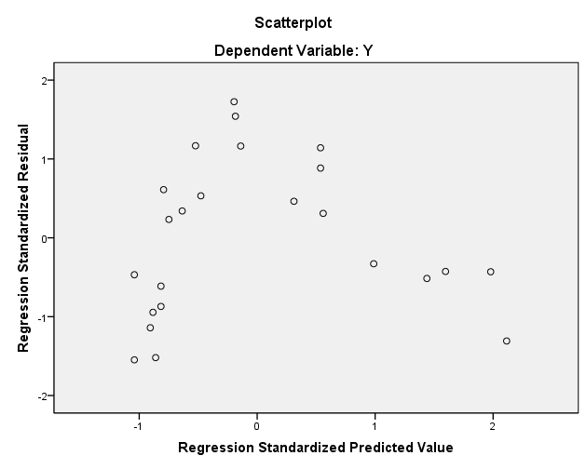
Testing the Functional Form of Regression Model
Any pattern in the residual plot would indicate incorrect specification (misspecification) of the model.

Slide 64
Test of Homoscedasticity
Breusch-Pagan (B-P) Statistical test for Heteroscedasticity.
Collect the unstandardized residuals from the Simple Linear Regression Model
In the presence of homoscedasticity, the residuals should not be dependent on X.
To check this run:

Slide 65
Test of Homoscedasticity
H0: residuals are homoscedastic vs H1: residuals are heteroscedastic
The B-P test uses a chi-square test statistic.
Failure to meet the homoscedasticity assumption will result in the unreliability of hypothesis tests.
This is due to the fact that the standard errors of the coefficient estimates tend to be larger (under heteroscedasticity) than what they should be.

Slide 66
Auto-Correlation
Auto-correlation is the correlation between successive error terms in a time-series data. Consider a time-series model as defined below:

Slide 67
Durbin−Watson Test for Auto-Correlation
Durbin−Watson is a hypothesis test to check the existence of auto-correlation (Durbin and Watson, 1950, . Let ρ be the correlation between error terms (ε_{t}, ε_{t−1}). The null and alternative hypotheses are stated below:
H0: ρ = 0
H1: ρ ≠ 0
The Durbin−Watson statistic, D, for correlation between errors of one lag is given by

Slide 68
Durbin−Watson Test for Auto-Correlation
D=2(1- )
D=2 implies
D=0 implies
D=4 implies
D= 1.5 implies
D=2.5 implies

Slide 69
Durbin−Watson Test for Auto-Correlation
D=2 implies there is no auto-correlation in the residuals.
2<D<=4 implies there is –ve auto-correlation in the residuals.
0<=D<2 implies there is +ve auto-correlation in the residuals.
As a rule of thumb, D values between 1.5 to 2.5 are considered to be normal.

Slide 70
The Durbin−Watson test has two critical values, D_{L} and D_{U}. The inference of the test can be made based on the following conditions:
If D < D_{L}, then the errors are positively correlated.
If D > D_{L}, then there is no evidence for positive auto-correlation.
If D_{L} < D < D_{U}, the Durbin−Watson test is inconclusive.
If (4 − D) < D_{L}, then errors are negatively correlated.
If (4 − D) > D_{U}, there is no evidence for negative auto-correlation.
If D_{L} < (4 − D) < D_{U}, the test is inconclusive.

Slide 71
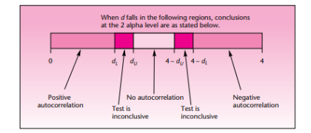

Slide 72
Impacts of Auto-Correlation on Regression Model
In the presence of auto-correlation, the standard error estimate of the beta coefficient may be underestimated.
Thus the corresponding t-statistic values are over-estimated.
This will lead to lower p-values than actual.
Thus a X variable with no significant statistical relationship with Y tends to get accepted in the model.

Slide 73
Impacts of Assumptions on Regression Model
 | SLR where residuals are normal, homoscedastic & auto-correlation =0 | SLR where residuals are heteroscedastic | SLR where residuals have auto-correlation !=0
beta1 value | 3076.1774 | 3076.1774 | 3076.1774
Standard error (beta1) | 1031.526 | 2000 (example) | 500 (example)
T-stat | 2.982 | 1.54 | 6.15235
P-value | 0.00449 | 0.131 | 0.000000
Explanation |  | Over-estimation of standard error leads to increase in p-value. Decision of hypothesis test changes. | Under-estimation of standard error leads to decrease in p-value.

Slide 74
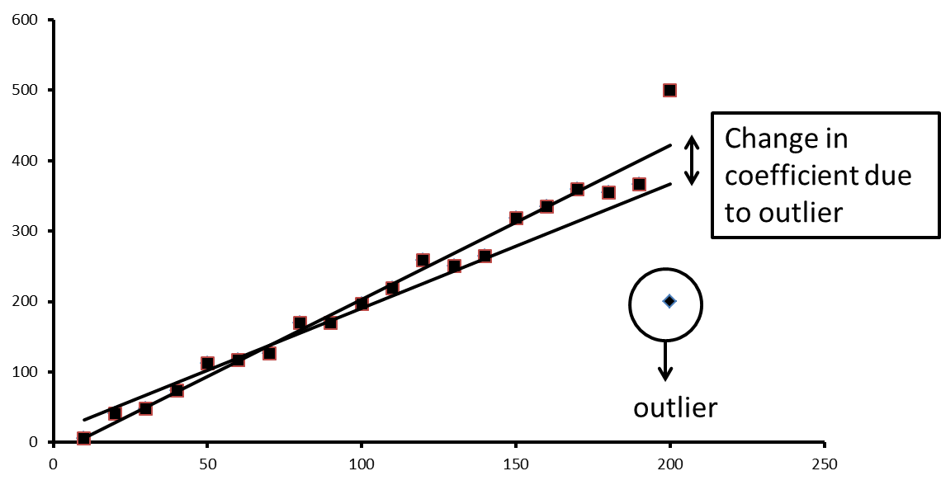
Outlier Analysis
Outliers are observations whose values show a large deviation from mean value, that is ( ) large
Presence of an outlier can have significant influence on values of regression coefficients. Thus, it is important to identify the existence of outliers in the data

Slide 75
Z-Score
Z-score is the standardized distance of an observation from its mean value. For the predicted value of the dependent variable Y, the Z-score is given by
Where and are, respectively, the mean and the standard deviation of dependent variable estimated from the sample data.
Any observation with Z-score >3 or <-3 may be flagged as an outlier.

Slide 76
Mahalanobis Distance
Mahalanobis distance is the distance between specific values of the independent variable (X_{i}) to the centroid of all observations of the explanatory variable. Distances value of more than chi-square critical value (with degrees of freedom is equal to the number of explanatory variables) is classified as outliers.
CHISQ.INV.RT(alpha = 0.05, degrees of freedom =1 (no of X variables))- 3.84146
An observation with Mahalanobis distance > 3.84146 is an outlier.

Slide 77
Cook’s Distance
Cook’s distance measures how much the predicted value of the dependent variable changes for all the observations in the sample when a particular observation is excluded from sample for the estimation of regression parameters. Cook’s distance for simple linear regression is given by
where D_{i} is the Cook’s distance measure for i^{th} observation,
is the predicted value of j^{th} observation excluding i^{th} observation.
is the predicted value of j^{th} observation including i^{th} observation from the sample.
MSE is the Mean–Squared–Error.
Cook’s distance of > 1 indicates outliers / highly influential observation
$$D_{i}=\frac{\sum_{j}{(\overset{∧}{Y_{j}}−\overset{∧}{Y_{j(i)})^{2}}}}{(k+1)\text{MSE}}$$

Slide 78
Cook’s Distance
Calculating D1 (Cook’s distance for the 1st record):
Exclude the first row from your salary dataset so that your sample size is 50-1=49.
Run the regression model: Salary = alpha0 + alpha1*Grade10% on the new (reduced) data set.
New values of intercept & slope coefficient will be obtained.
Calculate the fitted / predicted values from the new model. These are labelled as:
These are the predicted values from the new regression model obtained after excluding the first record.

Slide 79
Cook’s Distance
Calculating D2 (Cook’s distance for the 2nd record):
Now include the 1st row & drop the 2nd row from the salary dataset. The dataset again has 49 rows.
The remainder of the process is same as D1.
These are the predicted values from the new regression model obtained after excluding the first record.

Slide 80
Leverage Value
Leverage value of an observation measures the influence of that observation on the overall fit of the regression function. Leverage value for an observation in SLR is given by
Leverage value of more than 2/n or 3/n is treated as highly influential observation. In Eq. the first term (1/n) will tend to zero for large value of n.

Slide 81
Outlier Analysis for Salary Data
Measure | Reference range for outliers | Salary data records flagged as potential outliers | Comments
Z-score | >3 or <-3 | None
Mahalanobis distance | ChiSQ critical (alpha =0.05, df=1)= 3.84 | 16th row (M distance = 7.27) | Further investigation using DFFit & DFBeta.
Cooks distance | >1 | None
Leverage value | > 3/n = 3/50=0.06 | Row no: 9; 14 & 16 | Further investigation using DFFit & DFBeta.

Slide 82
DFFit and DFBeta
DFFit is the change in the predicted value of Y_{i} when case i is removed from the data set. DFBeta is the change in the regression coefficient values when an observation i is removed from the data.
Row No | DFFit & Stdz DFFit | DFBeta1 & Stdz DFBeta1 | Reference ranges
9 | 11388.9; 0.53 | 476.04; 0.47 | Ref for Stdz DFBeta = 2/ sqrt (n) = 0.283
14 | 14202.3; 0.663 | 590; 0.59 | Ref for Stdz DFFit = 2*sqrt ((k+1)/n) = 0.4
16 | 12885.6; 0.441 | -427.03; - 0.414

Slide 83
Handling Outliers
Removing the outliers from the dataset.
Capping the extreme observations at reasonable values.
Robust regression algorithms – Huber regression (assigns less weight to data points identified as outliers; minimizes Huber loss function)

Slide 84
Confidence Interval for Regression coefficients β₀ and β₁
The standard error of estimates of and are given by
where
$$S_{e}=\sqrt{\frac{{\sum{\left(Y_{i}−\overset{∧}{Y_{i}}\right)}}^{2}}{n−2}}$$
Where S_{e} is the standard error of residuals and SSX =
The interval estimate or (1-α)100% confidence interval for and are given by

Slide 85
Confidence Interval for the Expected Value of Y for a Given X
Since the point estimates are subjected to higher levels of error, due to uncertainties around estimation of parameters and natural variation in the data around the predicted line, the user would like to know the interval estimate or the confidence interval for the conditional expected value.
The confidence interval of the expected value of Y_{i} for a given value of X_{i} is given by
Where the term is the standard error of E(Y|X).

Slide 86
Prediction Interval for the Value of Y for a Given X
The prediction interval of Y_{i} for a given value of X_{i} is given by
where the term, is the standard
error of Yi for a given Xi value.

Slide 87
For large n, the prediction interval will converge to
This is because, as n → ∞, the term
converges to 1

Slide 88
References
Hanley J A, (2004), “Transmuting women into men: Galton’s Family Data on Human Stature”, The American Statistician, 58(3), 237-243.
Harter H L, (1974), “Method of Least Squares and Some Alternatives – Part II”, International Statistical Review, 42(3), 235-282.
Harter H L, (1975), “Method of Least Squares and Some Alternatives – Part IV”, International Statistical Review, 43(2), 125-190.
Hodge G (2012), “The Ugly Truth of Online Dating: Top 10 Lies Told by Internet Daters”, The Huffington Post, 10 October 2012, available at http://www.huffingtonpost.com/greg-hodge/online-dating-lies_b_1930053.html, accessed on 21 April 2017.
Galton F (1886), “Regression Towards Mediocrity in Hereditary Stature”, The Journal of the Anthropological Institute Great Britain and Ireland, 15, 246-263.
Kutner M H, Nachtsheim C J, Neter J and Li W (2013), “Applied Linear Models”, Fifth Edtion, McGraw Hill, New Delhi.
Waugh F V (1961), “The Place of Least Squares in Econometrics”, Econometrica, 29(3), 386-396.

